Slide 1
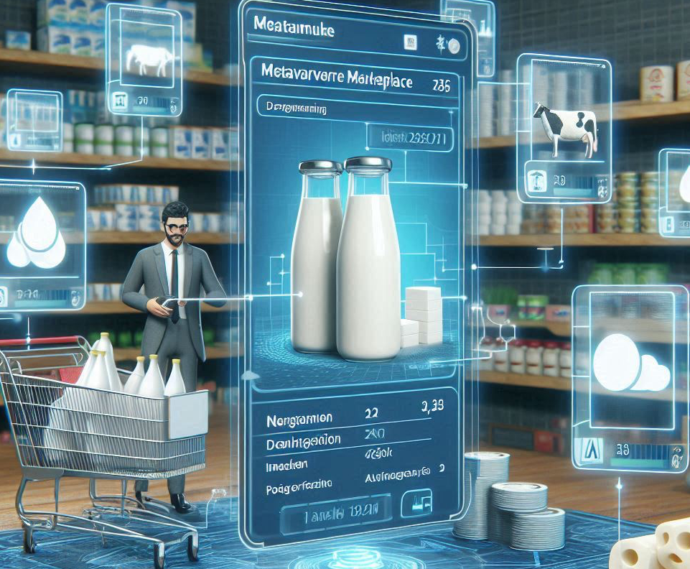



xPAYMENTS: Cross-Domain End-to-End Payment Protocol using PCN
Anupa De Silva, Subhasis Thakur, John Breslin
University of Galway
Ireland
AI Generated by MS

Slide 2
Outline
Background
Problems with blockchains
Payment channel networks
Problem definition
Aim
Cyclic exchange
Implementation and results
Conclusion

Slide 3

Blockchain Technology
Decentralized digital ledger
Securely stores records across a network of computers
transparent
immutable
tamper-resistant
Enables fair participation.
Application criteria
Data provenance issue: the gap between physical and digital worlds.
Notes:
For example, payment applications prioritise transaction throughput and resistance to double spending, while data applications focus on securely storing and managing large volumes of information.

Slide 4
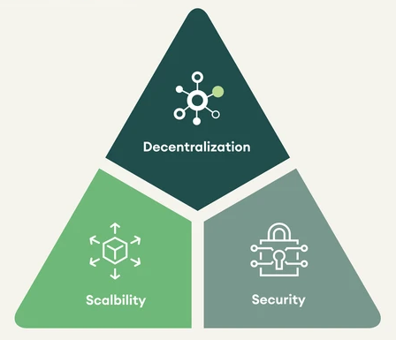
Proliferation of blockchains.
Blockchain Trilemma
No single all-in-one blockchain effectively meets the diverse needs, challenges, and opportunities presented by different use cases.
The blockchain trilemma poses a theoretical limitation, making it challenging to simultaneously achieve high levels of decentralisation, scalability, and security.
Implementors often prioritise certain attributes based on their speciﬁc use case requirements, goals, and constraints.
Coexistence Issue
Notes:
For example, payment applications prioritise transaction throughput and resistance to double spending, while data applications focus on securely storing and managing large volumes of information.

Slide 5
Segregation & Interoperability
Decoupling ﬁnancial operations from data management offers a promising solution to the trilemma.
Proliferation of payment methods that lead to currency fragmentation, consequently causing liquidity challenges, price volatility, and uncertainty.
Enhances consumer convenience by allowing them to utilise their default ﬁnancial source across various applications and scenarios.
Enables developers to focus on achieving the optimal balance between scalability and security without encountering a dilemma.

Slide 6
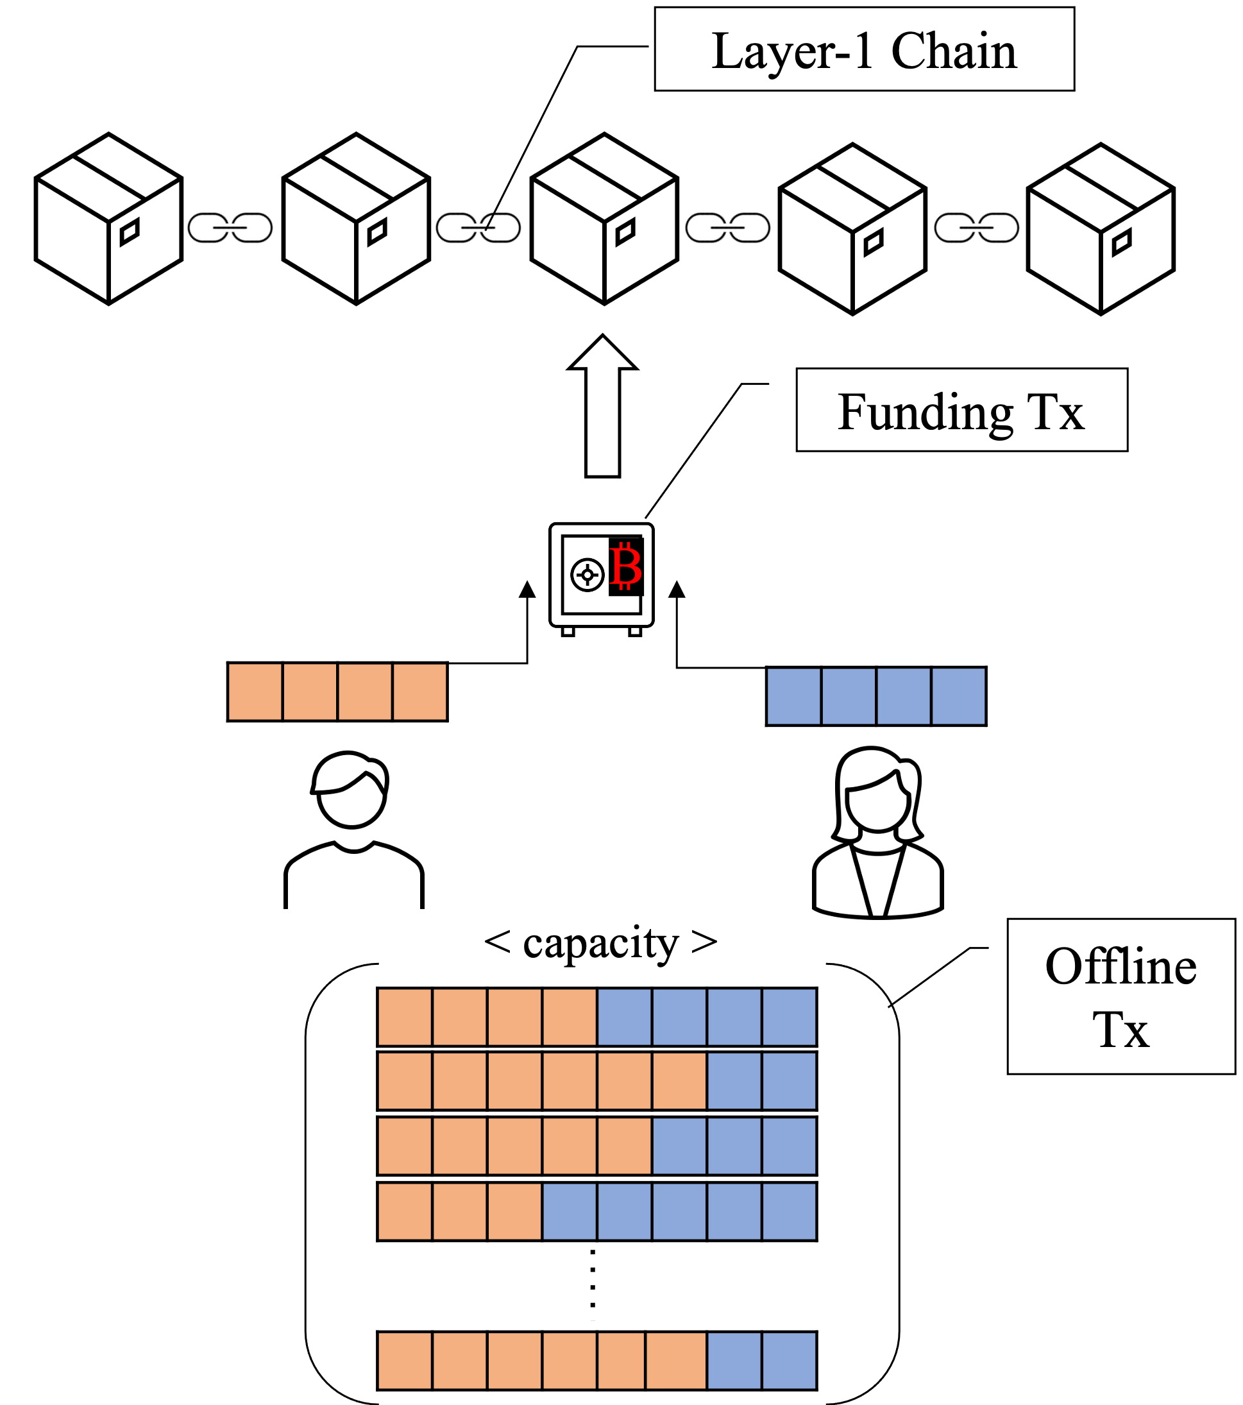
PCN Overview
A promising second-layer solution for the scalability issue of cryptocurrencies.
Exchanging ownership of money by keeping the state of the accounts local.
Features:
Transaction Efficiency
Cash like Privacy
Scalability
Notes:
Peer-2-peer network
Channel is the atomic

Slide 7
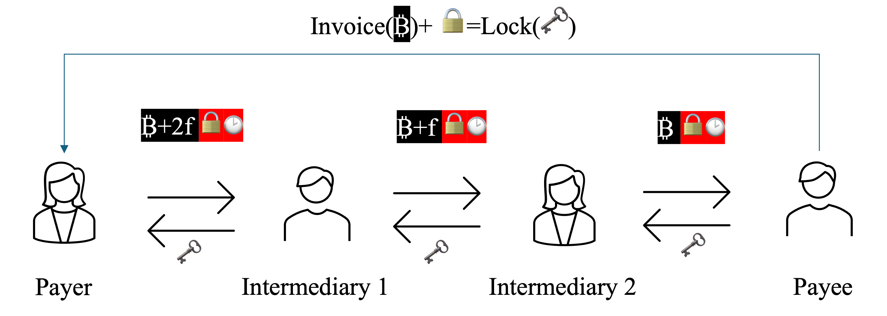
PCN Overview ctd.
Possible to route through other nodes.
Intermediaries must hold sufficient balance to successfully mediate the transaction.

Slide 8

Problem
Payments for decentralised, cross-domain, and end-to-end trading where the exchange between the product and the associated payment is intertwined but separate.
Notes:
The problem is recovering the money in a decentralised setting which is proven to be impossible.

Slide 9

Aim
A single payment method across multiple digital domains.

Slide 10
xPAYMENTS Cross-Domain End-to-End Payment Protocol
Independent payment mechanism that is interoperable with data management blockchains.
Payments: PCN
Interoperability: Atomic Swap

Slide 11
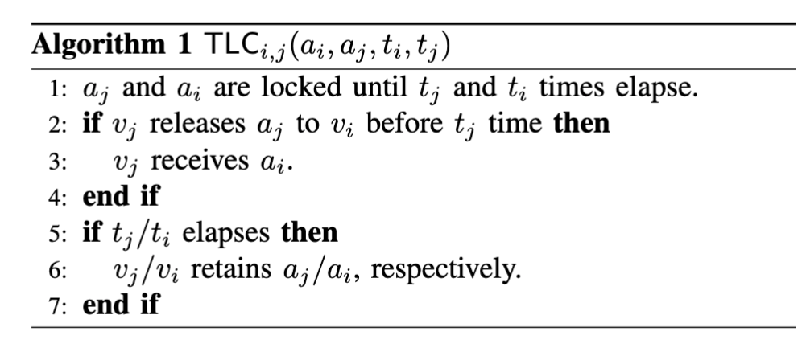
Time-Lock Contract
Time-Lock Contract : neither party can receive their respective assets without ﬁrst transferring their own.
V1
V0

Slide 12
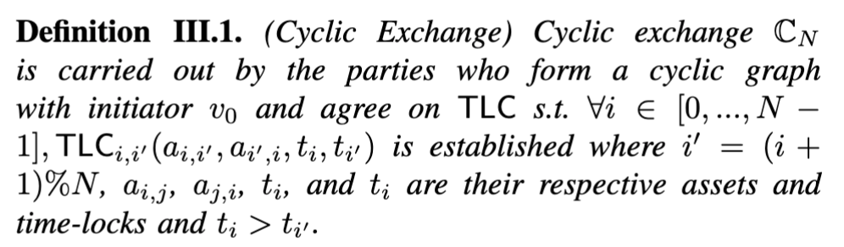
Cyclic Exchange
Cyclic Exchange: Exchange of assets forward and backward in a cyclic manner.
V3
V2
V1
V4
V0

Slide 13
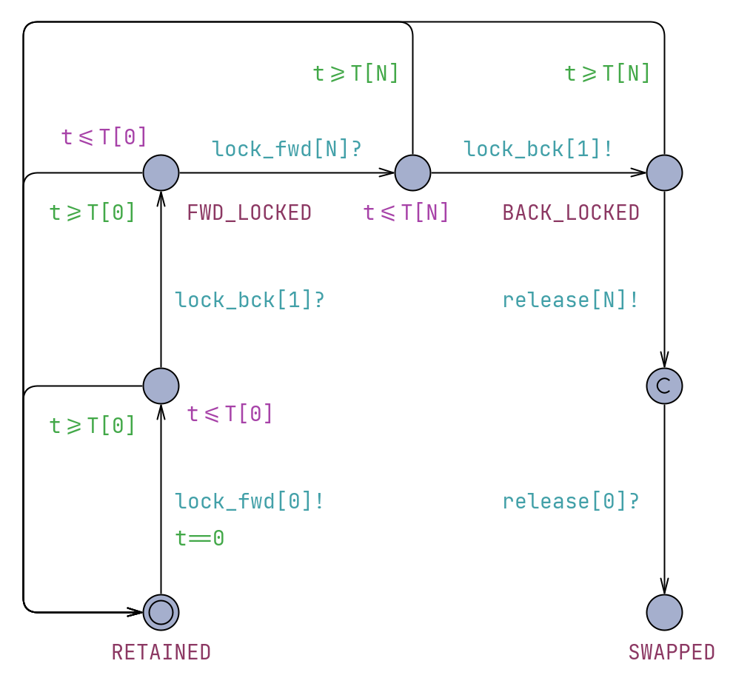
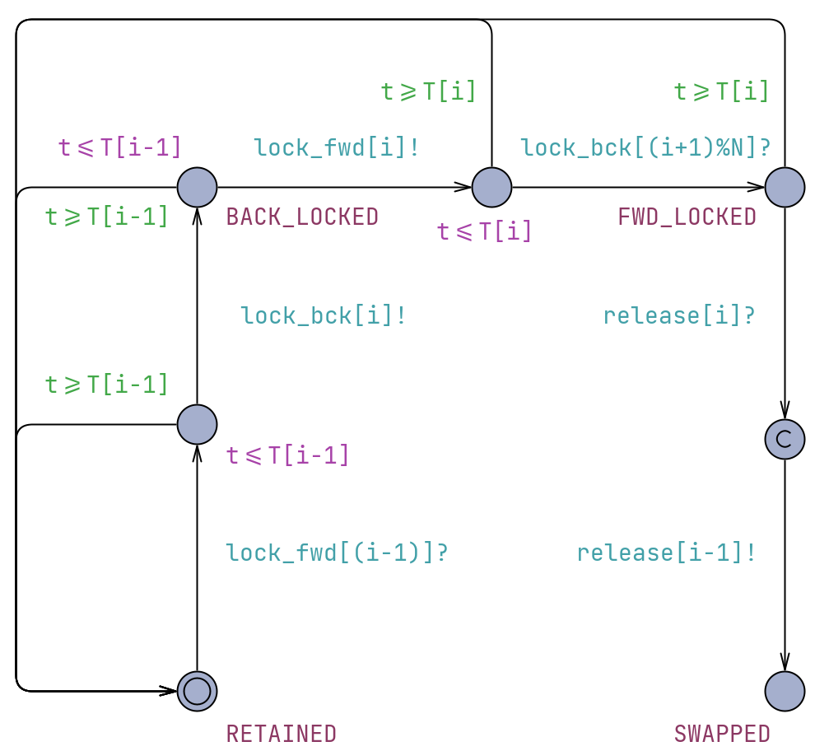
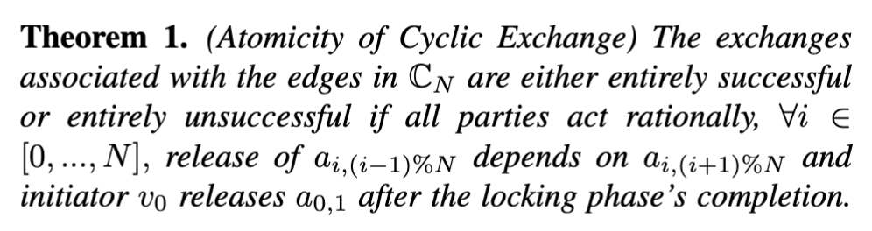
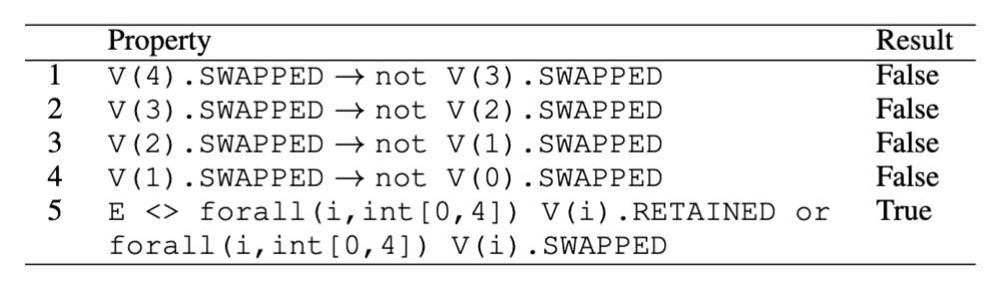
Cyclic Exchange
Atomicity proofs using Uppaal, modelling participants as finite automata.
Finite automaton of the initiator v₀ denoted by V(0).
Finite automaton of the vertex v_{i} denoted by V(i) (i ∈ [1, ..., N ]).
Computation Tree Logic

Slide 14
Applications
V3
V2
V1
V4
V0
Cyclic exchange can be applied,
when multiple parties are involved in different blockchains and want to exchange their assets, such as NFTs, tokens, and cryptocurrencies, directly with each other.
off-chain transactions, such as PCN where nodes engage in cyclic transfers to rebalance their channels.

Slide 15
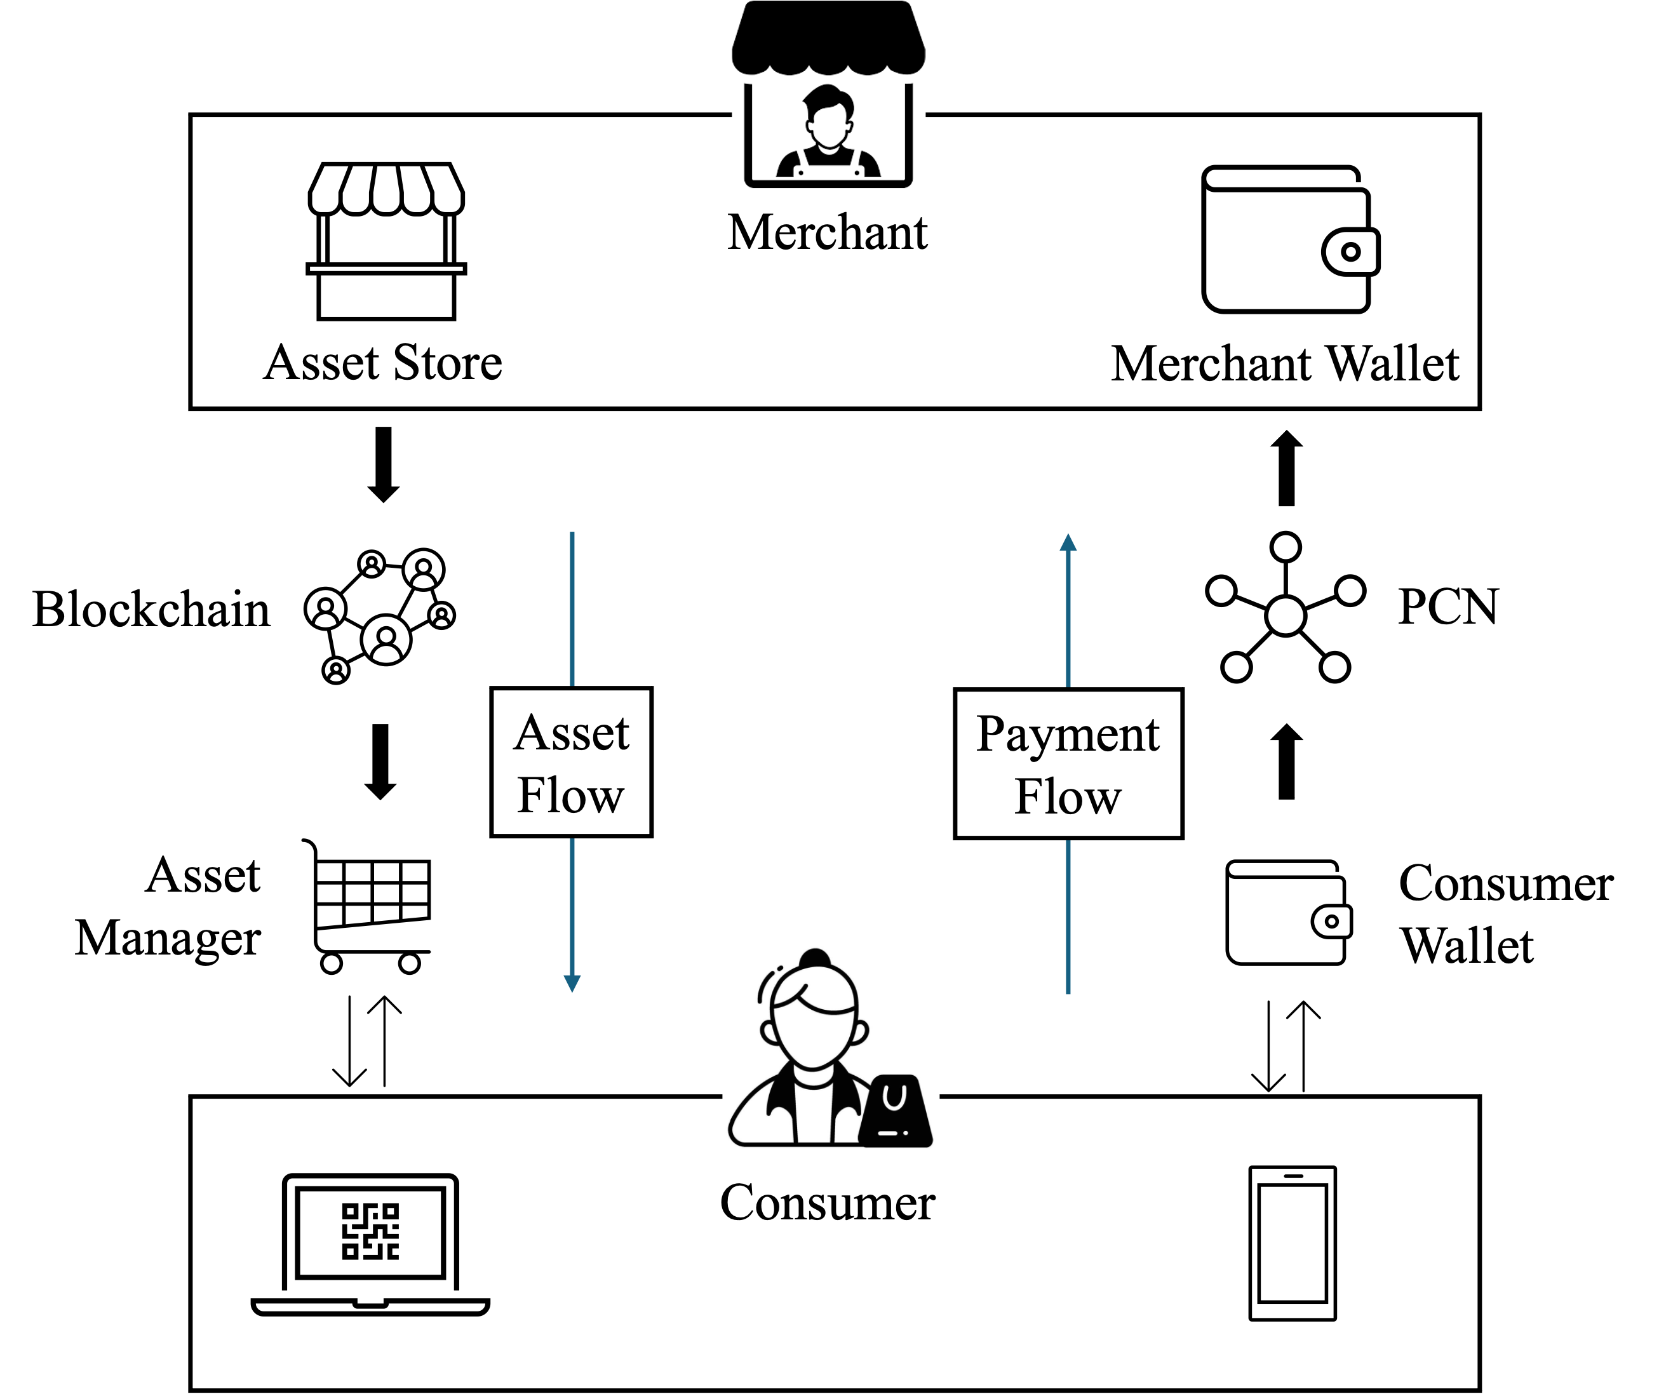
Implementation
PCN-based payment protocol, which facilitates end-to-end transactions.
Introduces cyclic exchange and formally verifies the atomicity using Uppaal.
Implementation using Hyperledger, Schnorr-based AMHL, and mobile app with modelling products as NFTs.
Can be found at github.com/anupasm/la_net/tree/main/xworld
Architecture
Notes:
Due to the proliferation blockchain it is impractical to perform financial activities in each an every blockchain. So as a consumer I would like to keep a single payment method for all applications. That is what we are presenting it as xPayments. We also ensures atomicity of the overall process, meaning that making the payment and receiving the digital asset is successful or not at all. For that we introduce cyclic exchange, formally verified its atomicty by Uppaal. And develop a poc which demonstrate minimum time consumption for the overall transaction.

Slide 16
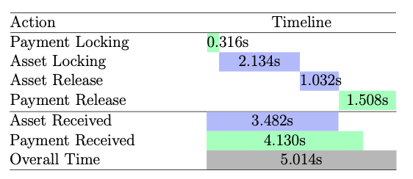
Results
Transaction time: Consumer 3.482s and Merchant: 4.130s
Average time taken of each phase of cyclic exchange
Notes:
Due to the proliferation blockchain it is impractical to perform financial activities in each an every blockchain. So as a consumer I would like to keep a single payment method for all applications. That is what we are presenting it as xPayments. We also ensures atomicity of the overall process, meaning that making the payment and receiving the digital asset is successful or not at all. For that we introduce cyclic exchange, formally verified its atomicty by Uppaal. And develop a poc which demonstrate minimum time consumption for the overall transaction.

Slide 17
Discussion
Discuss about minimised loss, controllable privacy, and atomicity
The proposed protocol is suitable for application involving two distinct environments, one of which operates as a monetary system facilitating the exchange of goods in the other environment.
Supply Chain Management
Metaverse
Gaming
.

Slide 18
Conclusion
This work presents an end-to-end trading protocol in a decentralised setting where the product exchange and the associated payment are intertwined.

Slide 19

Thank you
linkedin.com/in/anupasm

